Slide 1
机器人与人工智能实验室 Robotics and Artificial Intelligence Laboratory
WELCOME TO

Slide 2
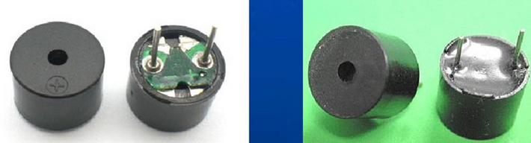
Buzzer Control
1. Introduction
The shape of the buzzer on Petoi is a flat cube with a small hole on it.
The principle of buzzer is mechanical oscillation. The audio signal current generated by the oscillator passes through the electromagnetic coil to generate magnetic field. Under the interaction of electromagnetic coil and magnet, the oscillating diaphragm periodically vibrates and makes sound.

Slide 3
Buzzer Control
2. Classification
(a) Active buzzer
(b) Passive buzzer

Slide 4
Buzzer Control
3. Remarks
The one with the green board is a passive buzzer. The one without board but sealed with black glue is an active buzzer.
The active buzzer has an oscillation source inside, so it will sound as soon as it is powered on. However, the passive buzzer does not have an oscillation source. Therefore, DC signal can not make it sound. A certain frequency of pulse signal must be given before the buzzer can sound.

Slide 5
Buzzer Control
4. Compare
Passive buzzer: cheap. The pulse signal of various frequencies can be given, and various tones can be made. But the control is a little complex, it cannot work with DC directly, it must be with AC signal.
By changing the frequency of the output waveform of the MCU pin, the buzzer can be adjusted and controlled to produce different timbres and tones (by changing the duty cycle of the output level, the volume of the buzzer can be adjusted).

Slide 6
Buzzer Control
4. Compare
Active buzzer: simple control. Sounding as long as powered on. But the tone is not easy to change. Because of the built-in oscillator, the cost is higher. By changing the voltage of the buzzer, the tone of can be changed, but it is not flexible enough.

Slide 7
Buzzer Control
5. Control
The buzzer on the cat is an active buzzer.
Note: the buzzer on the cat is fixed and welded to the 5 IO port of the MCU. Therefore, we must control through the 5 IO port.

Slide 8
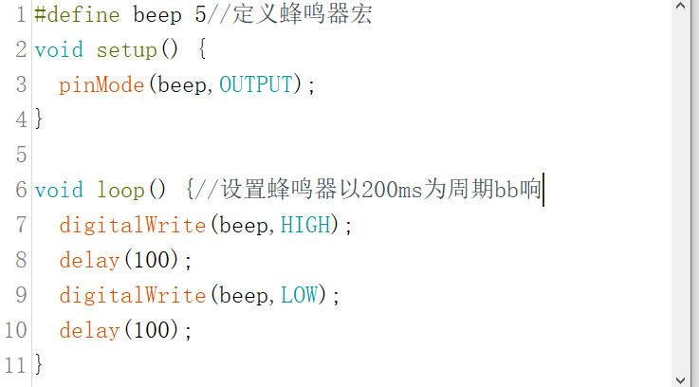
Buzzer Control
6. Coding

Slide 9

THANK YOU
林天麟 教授
香港中文大学（深圳）
机器人与人工智能实验室
WeChat: tinlunlam

